Slide 1

Homemade Food Delivery Management System
Course Code: CSE-416 · Software Project Design and Development Lab
SUBMITTED TO
SUBMITTED BY
Mr. Al-Imtiaz
Associate Professor & Head, Dept. of CSE, UITS
Md. Mefazur Rahman · Md. Shoyaif Rahman
Batch 53 · Spring 7th · Section 7A2 · 13/05/2026

Slide 2
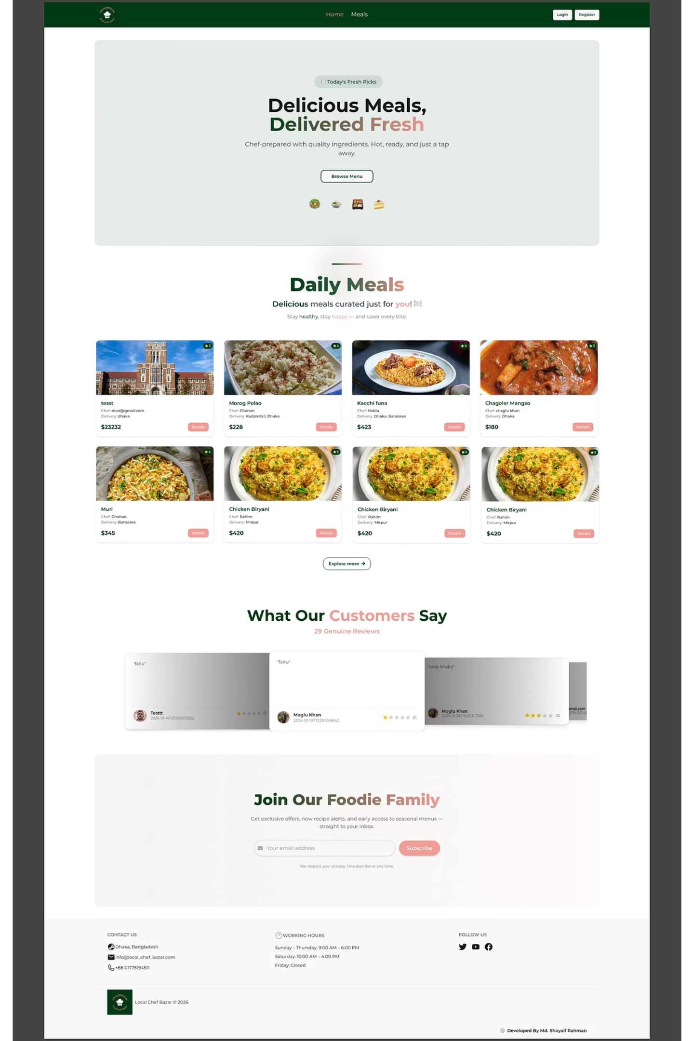
What is Home Made Food System?
A web platform connecting home cooks (Sellers) with food lovers (Customers) through a seamless, transparent ordering ecosystem.
Sellers
Customers
Register, list meals, manage food items
Browse, favorite, order & pay securely
Admins
Approve posts, manage users, monitor orders

Slide 3
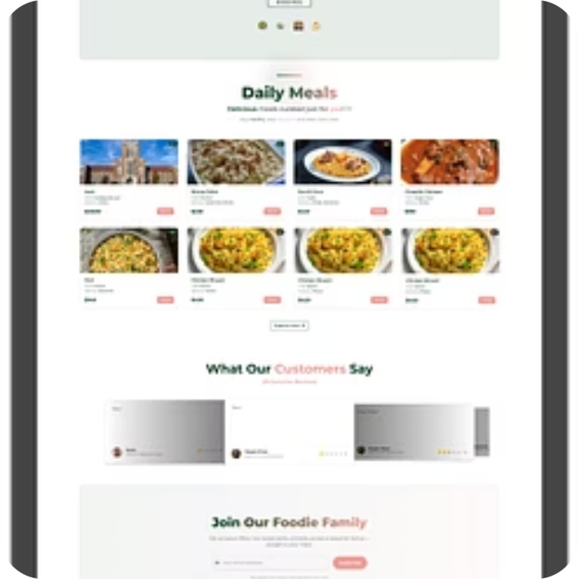
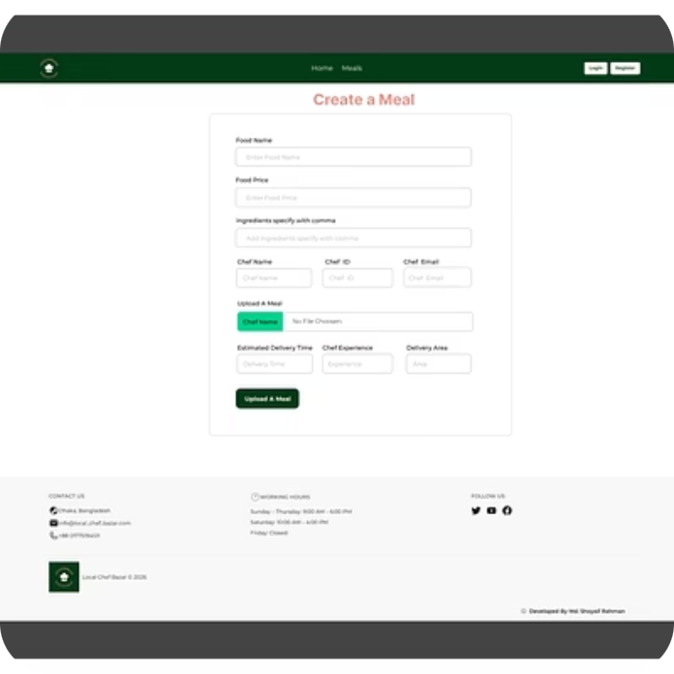
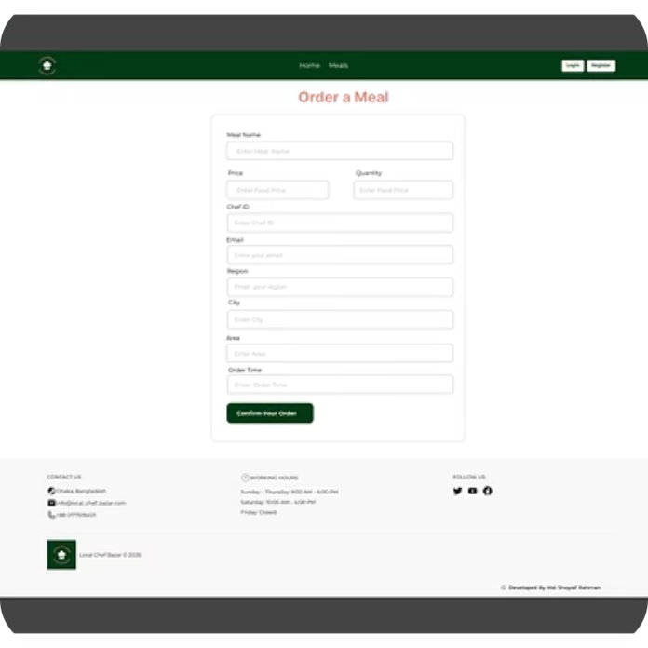
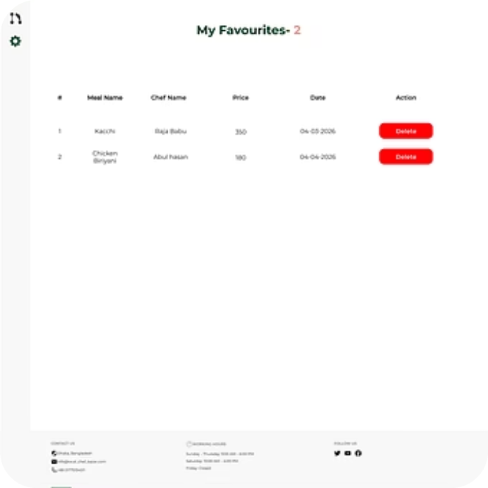
User Manual
GETTING STARTED
01
02
03
Register
Fill Profile
Login
Visit homepage → click Register → select role (Customer / Seller)
Name, email, photo, address, password → submit
Enter registered email & password. Admins use the Admin Login portal.
PLATFORM INTERFACE SHOWCASE
CHEF DASHBOARD
CUSTOMER DASHBOARD
Create / Edit / Delete meal listings
Monitor incoming Meal Orders
View & update profile
Browse & filter approved food
Add to Favorites → Place Order
Pay via Stripe · Track order status

Slide 4

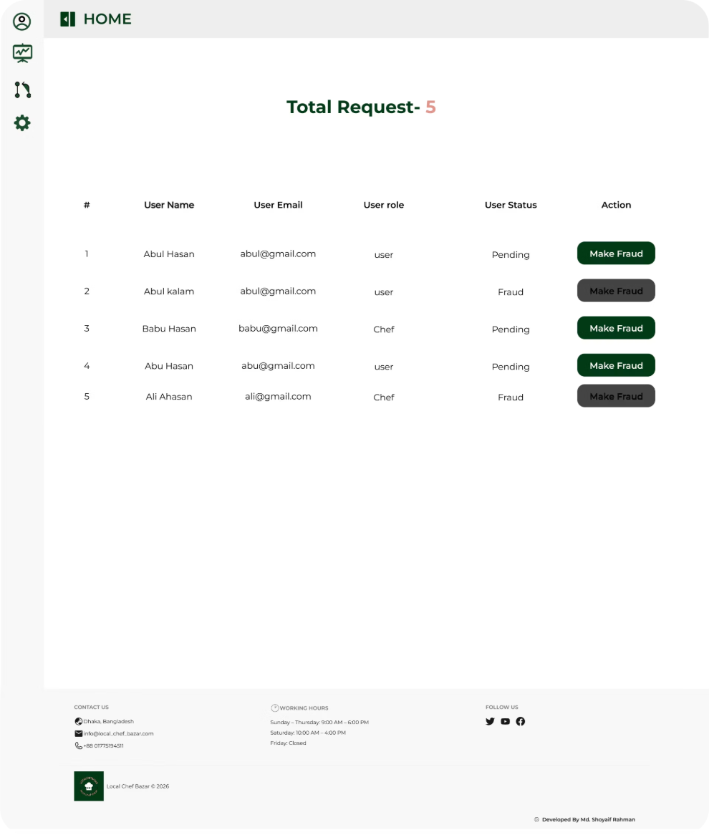
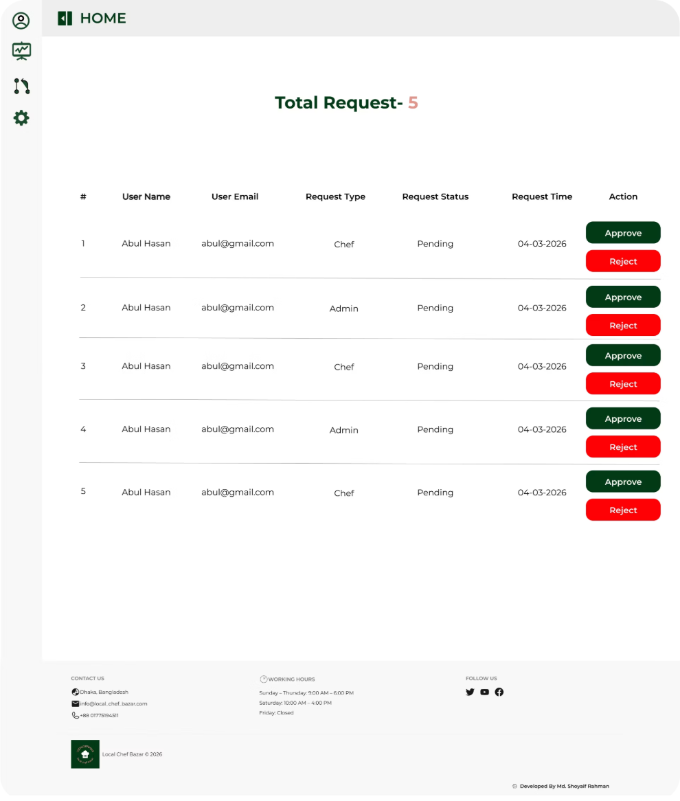
Admin Dashboard & System Constraints
Approve / Reject Posts
Review seller submissions with optional feedback
Manage Users
Activate, deactivate, or remove accounts
Monitor Orders
Full order details, payment & delivery progress
System Reporting
Order volume, active users, delivery performance
USER MANAGEMENT INTERFACE
REQUEST MANAGEMENT INTERFACE

Slide 5

Technology Stack
Frontend
Backend
React.js · Tailwind CSS · HTML5 · JavaScript
Node.js · Express.js · RESTful APIs
Database
Auth & Security
MongoDB Atlas — cloud-based storage
Firebase Auth · JWT · Role-based access control
Payment
Deployment
Stripe — secure online transactions
Netlify (frontend) · Vercel (backend)
Geographic Coverage: Available in 64 Districts

Slide 6
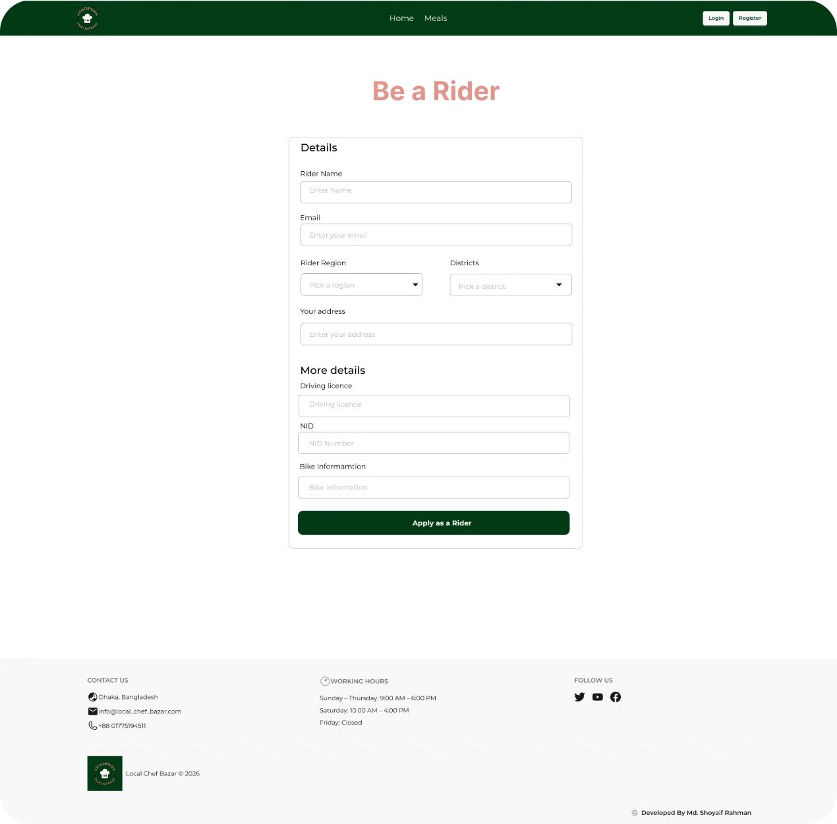
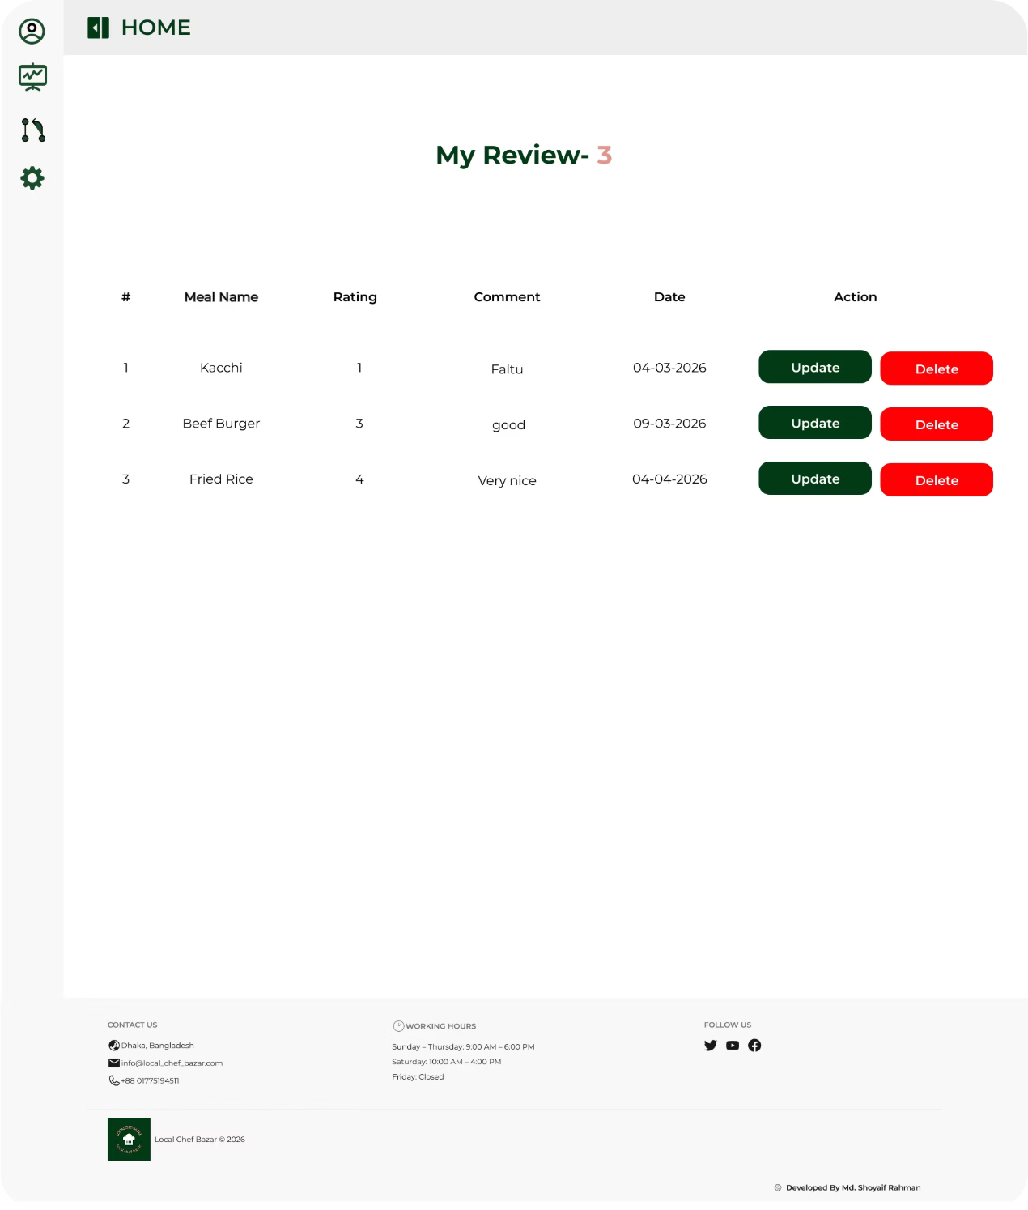
Rider & Customer Features
RIDER REGISTRATION FORM
Empowering riders to join the delivery network with a simple registration experience and easy management of delivery details.
CUSTOMER REVIEWS
Customers can share feedback and ratings to help maintain quality, transparency, and trust across the platform.

Slide 7
Functional & Non-Functional Requirements
FUNCTIONAL
NON-FUNCTIONAL
Auth & Sessions
Food Posting & Approval
Performance
Security
Multi-role login, RBAC, secure session management
Chef adds/edits/deletes; Admin approves before publish
1,000 concurrent users
Encrypted passwords · RBAC
Usability
Scalability
Ordering & Payment
Delivery Management
Fully responsive · multi-browser
Designed for growing user base
Browse → Order → Stripe payment → auto confirmation
Chef confirms; customer tracks real-time status

Slide 8
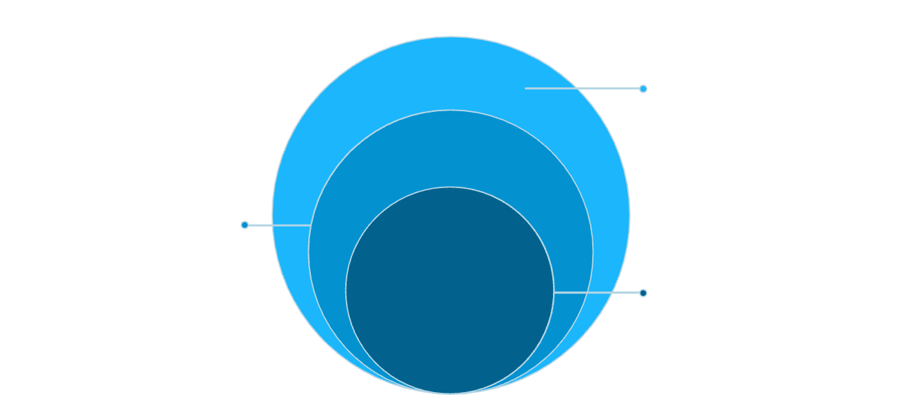
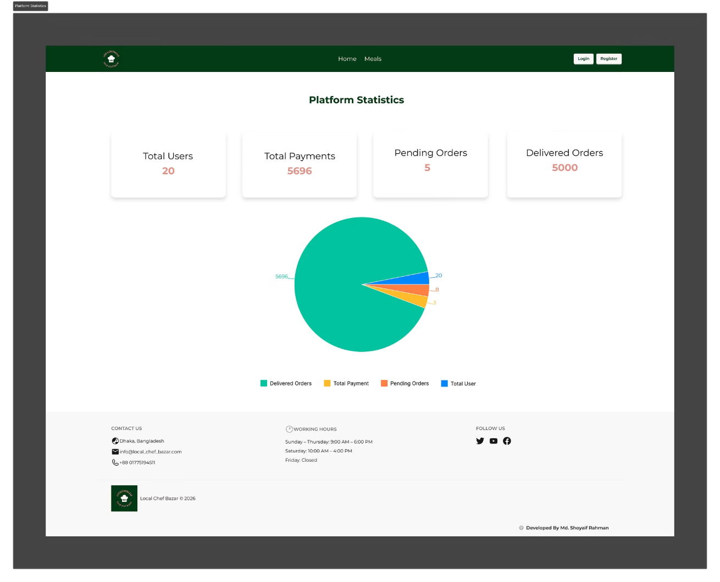
System Architecture & Modules
Data
MongoDB Atlas for storage and queries
Application
Node.js, Express, JWT, REST APIs
Presentation
React.js with Tailwind CSS for UI
SYSTEM MODULES
User Management
Registration, login, RBAC for Admin, Chef, Customer
Meal Management
Chef CRUD; Admin approval workflow
Browsing & Ordering
Search, filter, cart, place order
Payment Processing
Stripe integration, confirmation
Admin Dashboard
Analytics, approvals, user & order management

Slide 9
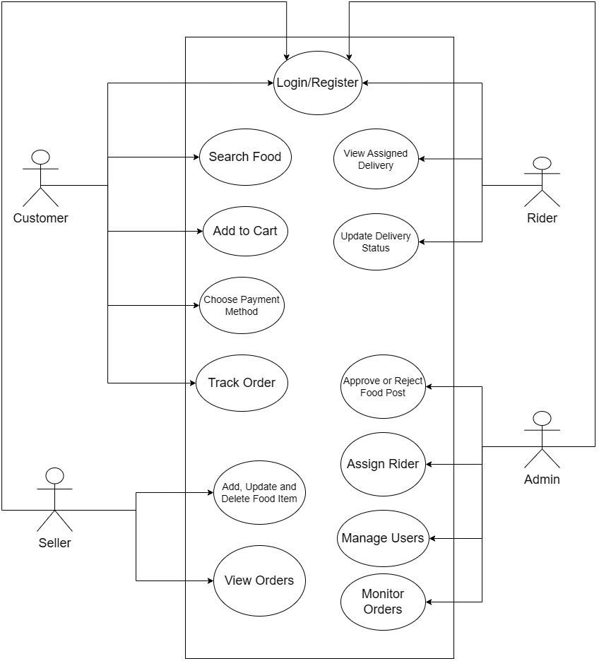
System Diagrams
USE CASE
Fig-1: Use Case Diagram
Shows interactions between four actors — Customer, Seller, Rider, Admin — and core system functions.
Customer: Search, Cart, Pay, Track
Seller: Add/Update/Delete Food, View Orders
Rider: Accept & Update Delivery
Admin: Approve Posts, Assign Rider, Manage Users

Slide 10
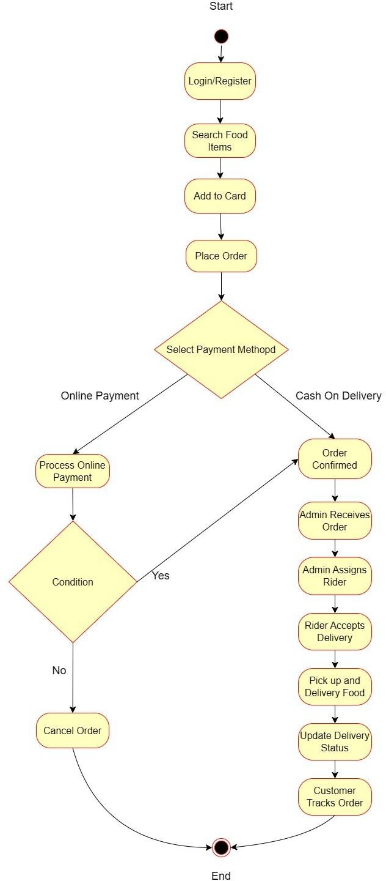
System Diagrams
ACTIVITY FLOW
Fig-2: Activity Diagram
Step-by-step order flow: Login → Search → Cart → Place Order → Payment → Rider Assignment → Delivery Tracking.
Online Payment: processed via Stripe. Cash on Delivery: confirmed directly by Admin.

Slide 11
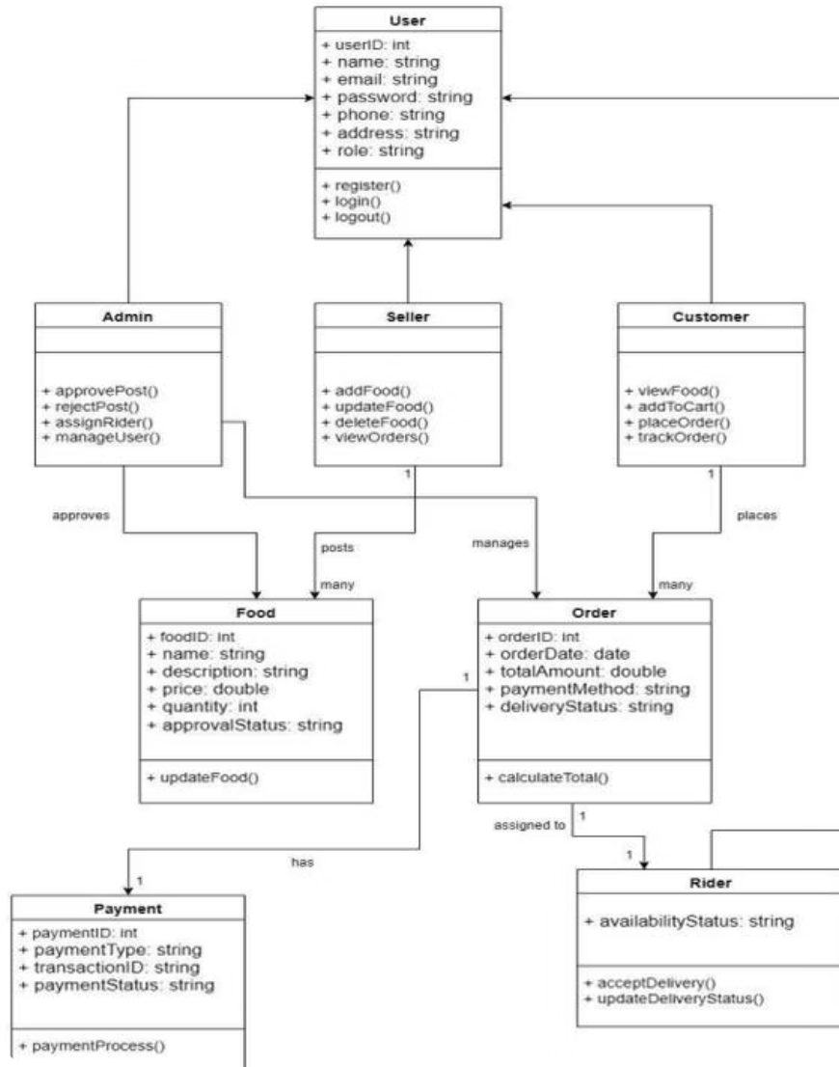
Class & Swimlane Diagrams
CLASS DIAGRAM
Fig-3: Class Diagram
Entities: User, Admin, Seller, Customer, Rider, Food, Order, Payment
User is base class for Admin, Seller, Customer
Admin approves Food; Seller posts Food
Customer places Orders; Order assigned to Rider & Payment

Slide 12
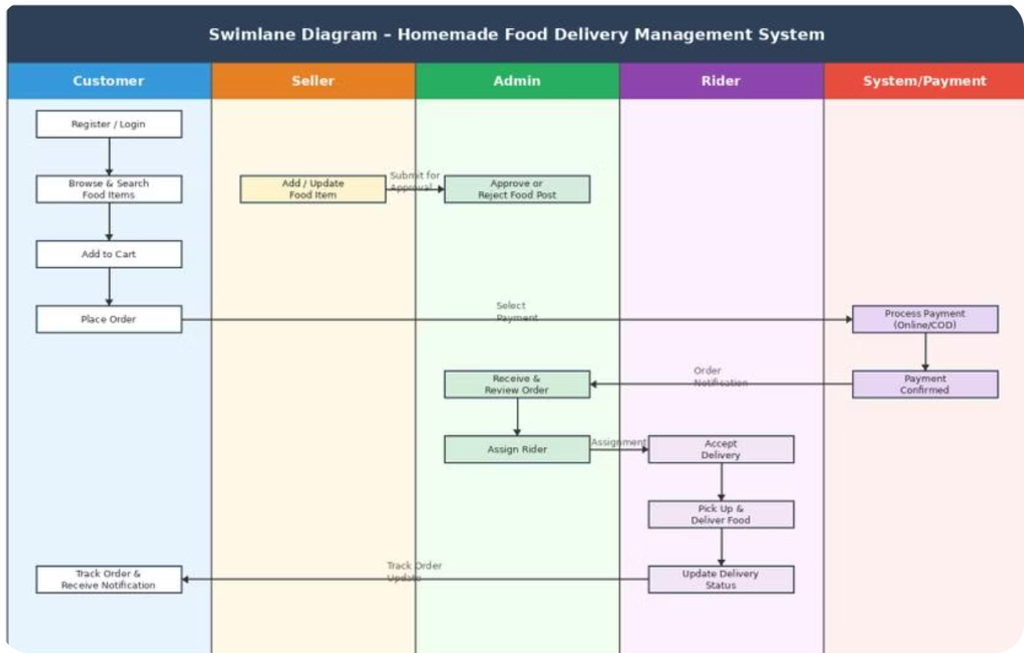
Class & Swimlane Diagrams
SWIMLANE DIAGRAM
Fig-4: Swimlane Diagram
Complete order lifecycle across 5 stakeholders: Customer · Seller · Admin · Rider · System/Payment
Customer places order → triggers payment & Admin review
Admin assigns Rider → Rider delivers & updates status
Customer receives live tracking notification

Slide 13

Conclusion & Course Alignment
Local Chef Bazar — a complete MERN stack marketplace connecting local chefs with food lovers.
CO1 — System Design
CO2 — Modern Tools
CO3 — Quality Assurance
SRS, UML diagrams, full architecture
MERN stack, Stripe, Firebase, JWT, RBAC
Admin approval workflow, testing & validation
CO4 — Complex Solution
CO5 — Communication
End-to-end order lifecycle, multi-role, real-time tracking
Full documentation, UML, swimlane, user manual

